Slide 1
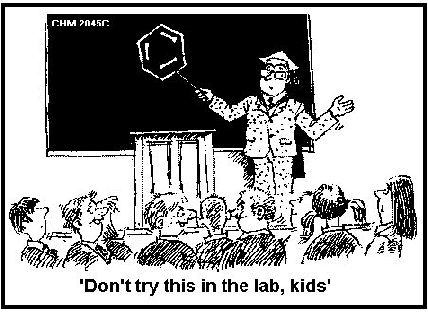
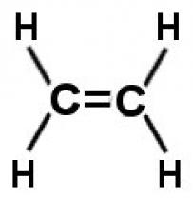
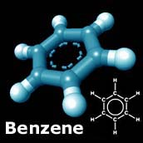
Alkenes, Alkynes, and Aromatic Compounds
(Chapter 13)

Slide 2
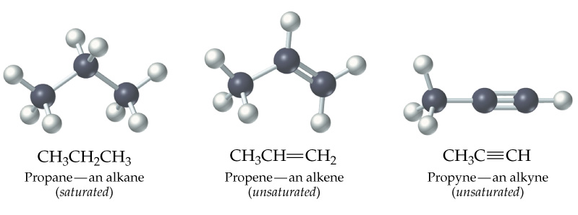
Alkenes and Alkynes
Unsaturated
  contain carbon-carbon double and triple bond to which more hydrogen atoms can be added.
Alkenes: carbon-carbon double bonds
Alkynes: carbon-carbon triple bonds.

Slide 3
Naming Alkenes and Alkynes
IUPAC nomenclature rules for alkenes and alkynes are similar to alkanes.
Step 1. Name the parent compound. Find the longest chain containing the double or triple bond, and name the parent compound by adding the suffix –ene or –yne to the name of the main chain.

Slide 4
Step 2: Number the carbon atoms in the parent chain, beginning at the end nearest to the double or triple bond. If the multiple bond is an equal distance from both ends, begin numbering at the end nearer the first branch point. The number indicates which carbon the multiple bond is AFTER. (i.e. between 2 and 3 is 2-)
Step 3: Assign numbers and names to the branching substituents, and list the substituents alphabetically. Use commas to separate numbers, and hyphens to separate words from numbers.

Slide 5
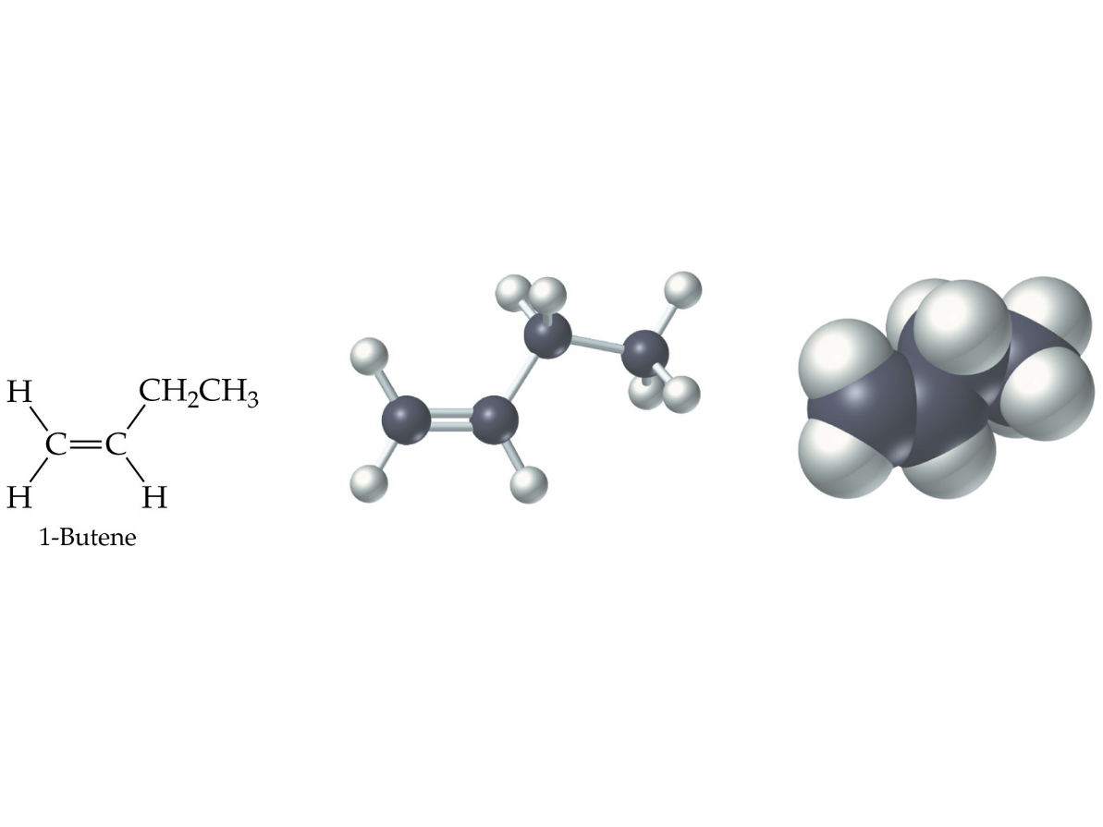
Step 4. Indicate the position of the multiple-bond carbon. If more than one multiple bond is present, identify the position of each multiple bond and use the appropriate ending diene, triene, tetraene, and so forth.
Step 5. Assemble the name.

Slide 6
Naming Alkenes and Alkynes
When the carbon chain has 4 or more C atoms, number the chain to give the lowest number to the double or triple bond.
1 2 3 4
CH₂=CHCH₂CH₃ 1-butene but-1-ene
CH₃CH=CHCH₃ 2-butene but-2-ene
CH₃C≡CCH₃ 2-butyne but-2-yne

Slide 7
Assigning Priority
Alkenes and alkynes are considered to have equal priority
In a molecule with both a double and a triple bond, whichever is closer to the end of the chain determines the direction of numbering.
In the case where each would have the same position number, the double bond takes the lower number.
In the name, “ene” comes before “yne” because of alphabetization.

Slide 8
Learning Check
Write the IUPAC name for each of the following unsaturated compounds:
A. CH₃CH₂C≡CCH₃
CH₃
B. CH₃C=CHCH₃ C.

Slide 9
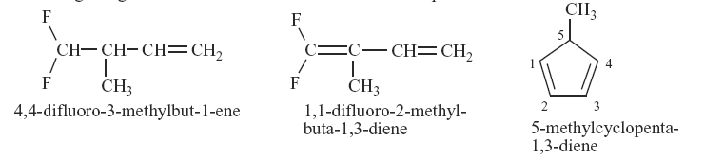
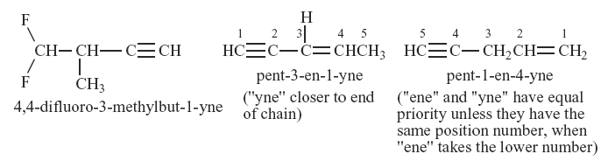
Multiple Double/Triple Bonds

Slide 10
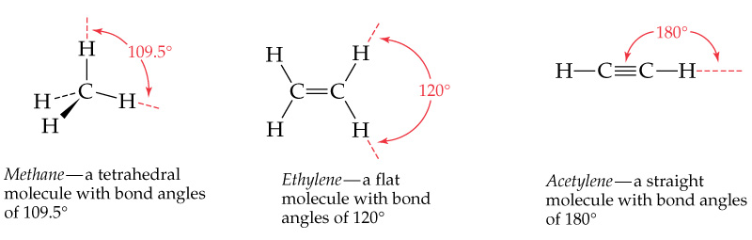
Cis-Trans Isomerism
Methane is tetrahedral, ethylene is planar, and acetylene is linear as predicted by the VSEPR theory discussed earlier.

Slide 11
Cis and Trans Isomers
Double bond is fixed
Cis/trans Isomers are possible
CH₃ CH₃ CH₃
CH = CH CH = CH
cis trans CH₃

Slide 12
Cis- and Trans- terminology
If alkenes have two different substituents at each end of the C=C then they can exist as stereoisomers because there is restricted rotation of the double bond.
For example:
all terminal alkenes (begin or end with a C=CH₂) do not exist as cis- and trans- isomers.
all 1,1-symmetrically disubstituted alkenes (has a C=CR₂ unit) do not exist as cis- and trans-.
alkenes with the R-CH=CH-R unit can exist as cis- and trans- isomers.

Slide 13
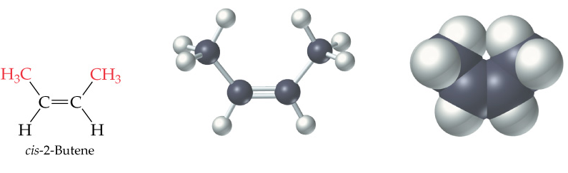
In cis isomers, two methyl groups are close together on the same side of the double bond.

Slide 14
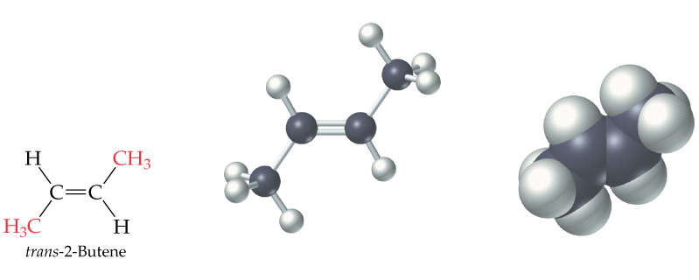
In trans isomer, two methyl groups are far apart on opposite side of the double bond.
Both cis and trans isomers have the same formula and connections between the atoms but have different three dimensional structures because the way the groups are attached to the carbons.

Slide 15
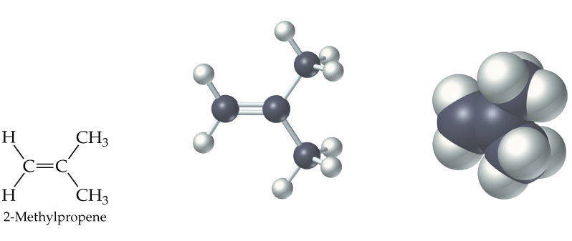
Cis-trans isomerism occurs in an alkene whenever each double bond carbon is bonded to two different substituent groups. Cis-trans isomerism is not possible if one of the double bond carbons is attached to two identical groups.

Slide 16
Unsaturated Fatty Acids
Fatty acids in vegetable oils are omega-6 acids (the first double bond occurs at carbon 6 counting from the methyl group)
A common omega-6 acid is linoleic acid
CH₃CH₂CH₂CH₂CH₂CH=CHCH₂CH=CH(CH₂)₇COOH
6
linoleic acid, a fatty acid

Slide 17
Trans Fats
In vegetable oils, the unsaturated fats usually contain cis double bonds.
During hydrogenation, some cis double bonds are converted to trans double bonds (more stable) causing a change in the fatty acid structure
If a label states “partially” or “fully hydrogenated”, the fats contain trans fatty acids.

Slide 18
Trans Fats
In the US, it is estimated that 2-4% of our total Calories is in the form of trans fatty acid.
trans fatty acids behave like saturated fatty acids in the body.
Several studies reported that trans fatty acids raise LDL-cholesterol. Some studies also report that trans fatty acid lower HDL-cholesterol
The trans fatty acids controversy will continue to be debated.

Slide 19
Fats and Atheroschlerosis
Inuit people of Alaska have a high fat diet and high blood cholesterol levels, but a very low occurrence of atherosclerosis and heart attacks.
Fat in the Intuit diet was primarily from fish such as salmon, tuna and herring rather than from land animals (as in the American diet).

Slide 20
Omega-3 Fatty Acids
Fatty acids in the fish oils are mostly the omega-3 type (first double bond occurs at the third carbon counting from the methyl group).
linolenic acid 18 carbon atoms
CH₃CH₂CH=CHCH₂CH=CHCH₂CH=CH(CH₂)₇COOH
↑
eicosapentaenoic acid (EPA) 20 carbon atoms CH₃CH₂(CH=CHCH₂)₅(CH₂)₂COOH

Slide 21
Atherosclerosis
Plaques of cholesterol adhere to the walls of the blood vessels
Blood pressure rises as blood squeezes through smaller blood vessels
Blood clots may form
Omega-3 fatty acids decrease the “sticking” of blood platelets (fewer blood clots)
Omega-3 fatty acids can increase bleeding time

Slide 22
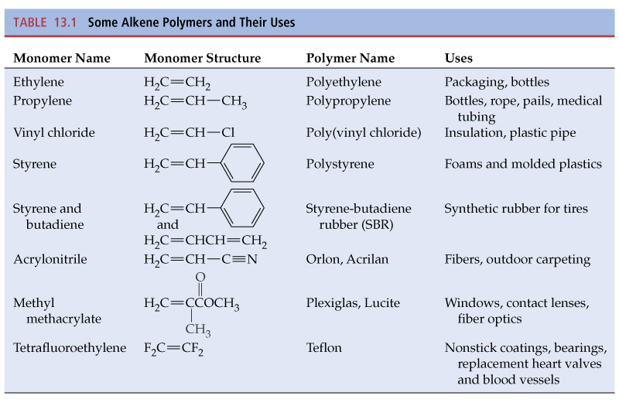

Slide 23
Name These

Slide 24
Aromatic Compounds and Benzene
Aromatic compounds contain benzene.
Benzene, C₆H₆ , is represented as a six carbon ring with 3 double bonds.
Two possible can be drawn to show benzene in this form.

Slide 25
Aromatic Compounds and the Structure of Benzene
In the early days the word aromatics was used to described many fragrant molecules isolated from natural sources. Today the term aromatic is used to describe benzene like molecules.
Benzene is a flat, symmetrical molecule with the molecular formula C₆H₆.
It has alternating three carbon-carbon double and three single bonds.

Slide 26
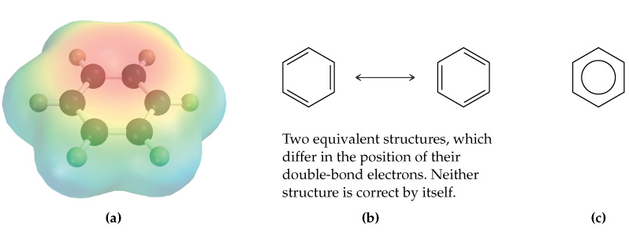
Benzene’s relatively lack of chemical reactivity is due to its structure.
There are two possible structures with alternating double and single bonds.

Slide 27
Experimental evidence suggest that all six carbon-carbon bonds in benzene are identical.
The properties, including the above one, of benzene can only be explained by assuming that the actual structure of benzene is an average of the above two possible equivalent structures-known as resonance.
Simple aromatic compounds like benzene are non-polar, insoluble in water, volatile, and flammable.
Unlike alkenes, several aromatic hydrocarbons are toxic. Benzene itself is implicated as a cancer causing chemical.

Slide 28
Aromatic Compounds in Nature and Health
Many aromatic compounds are common in nature and in medicine.

Slide 29
Naming Aromatic Compounds
Aromatic compounds are named with benzene as the parent chain. One side group is named in front of the name benzene.
  - No number is needed for mono-substituted benzene since all the ring positions are identical.
methylbenzene chlorobenzene
(toluene)

Slide 30
Naming Aromatic Compounds
When two groups are attached to benzene, the ring is numbered to give the lower numbers to the side groups. The prefixes ortho (1,2), meta (1,3-) and para (1,4-) are also used.

Slide 31
Some Common Names
Some substituted benzene rings also use a common name. Then naming with additional more side groups uses the ortho-, meta-, para- system.

Slide 32
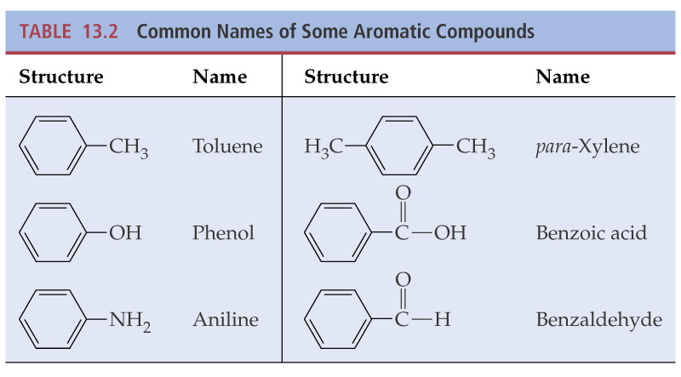
Many substituted aromatic compounds have common names in addition to their systematic names.

Slide 33
Learning Check
Select the names for each structure:
a. Chlorocyclohexane
b. Chlorobenzene
c. 1-chlorobenzene
a. Meta-xylene
b. Meta-dimethylbenzene
c. 1,3-dimethylbenzene

Slide 34
Learning Check
Write the structural formulas for each of the following:
A. 1,3-dichlorobenzene
B. Ortho-chlorotoluene

Slide 35
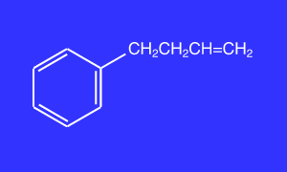

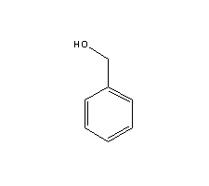

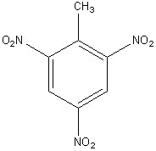
New Attached Groups
Phenyl
Benzyl
Nitro -NO₂
4-phenyl-1-butene
Benzyl alcohol
Refer to your chart for order of priority!
2,4,6-trinitrotoluene

Slide 36
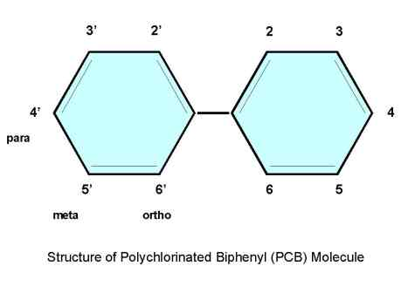
PCBs
(Polychlorinated Biphenyls)
There are 209 varieties of PCBs, known individually as congeners. A congener may have between 1 and 10 chlorine atoms, which may be located at various positions on the PCB molecule.

Slide 37
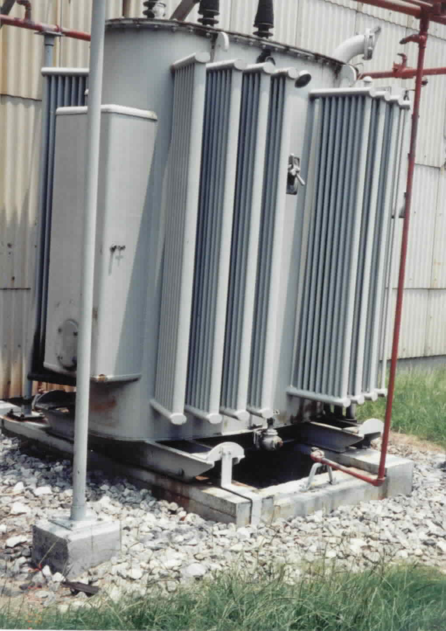
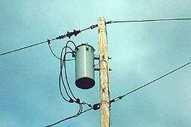
PCBs
PCBs are mixtures of man-made chemicals with similar chemical structures. PCBs can range from oily liquids to waxy solids. Due to their non-flammability, chemical stability, high boiling point and electrical insulating properties, PCBs were used in hundreds of industrial and commercial applications including electrical, heat transfer, and hydraulic equipment; as plasticizers in paints, plastics and rubber products; in pigments, dyes and carbonless copy paper and many other applications. More than 1.5 billion pounds of PCBs were manufactured in the United States prior to cessation of production in 1977.

